Slide 1
Computer Architecture Concepts
Part 7 – Data Representation: Images

Slide 2
Objectives
To have some understanding of:
BMP file formats for storing images
Metadata
Pixel data

Slide 3
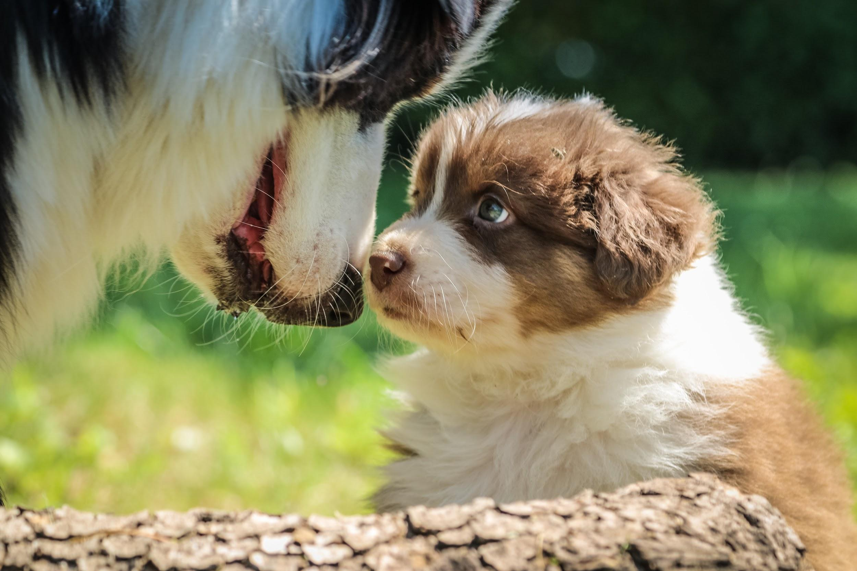


Pixels
A pixel is the smallest component of an image
Short for picture element
A bitmap is a way of representing an image using a grid arrangement of pixels
Notes:
Image source: photo by Jametlene Reskp on Unsplash (unsplash.com/photos/hGKXqee3Zxw)

Slide 4

Mixing colours
Primary colours (of light)
red, green, blue (RGB)
Secondary colours
green and red makes yellow
blue and green makes cyan
red and blue makes magenta
We often write colours as a list of three numbers in the order Red, Green, Blue each between 0 and 255
( 255, 0 , 0 ) is red
Image from www.raspberrypi.org

Slide 5
Mixing colours
Using numbers from 0 to 255 allows one byte (8 bits) for each of red, green, and blue – for each pixel
This is gives a colour depth of 24-bit RGB which is a common standard.
Image from www.raspberrypi.org

Slide 6

Colour images
000 | 001 | 010 | 011 | 100 | 101 | 110 | 111
If we have a smaller colour palette, we can use fewer bits for each pixel.
We can represent 8 different colours with a minimum of 3 bits.
Colour depth is the number of bits available to store the colour of each pixel.
It affects the file size
Notes:
Image source: https://publicdomainvectors.org/en/free-clipart/Pixel-art-helicopter/65929.html (public domain)

Slide 7
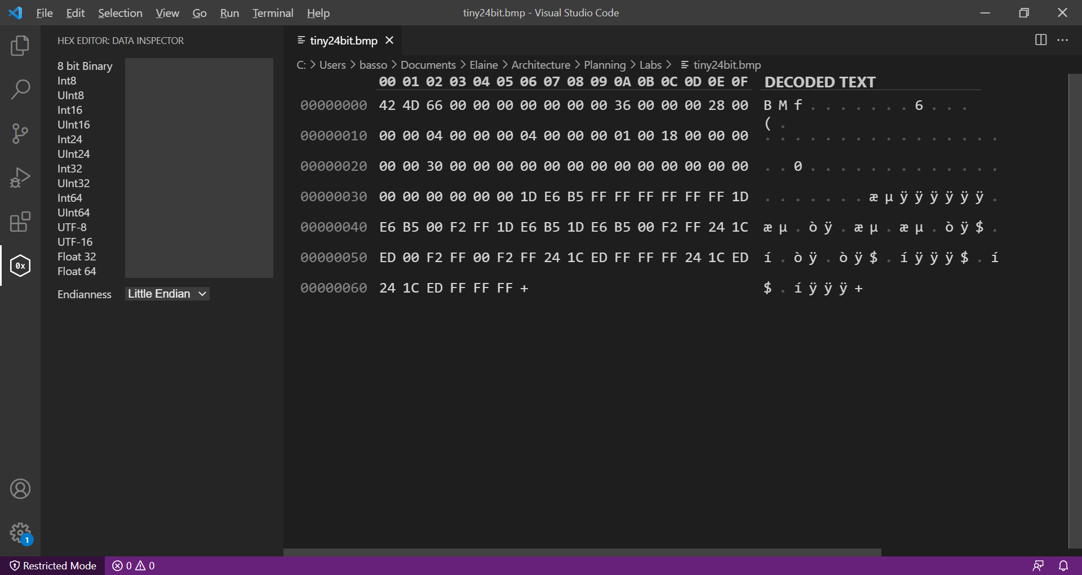
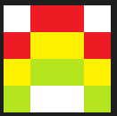
Looking at a bmp file - metadata
Width of image
Height of image
Number of bits per pixel

Slide 8
Looking at a bmp file - metadata
Position of start of pixel array
Size of the rest of the header
File Size

Slide 9
Looking at a bmp file - metadata
Number of bytes of pixel data
End of metadata

Slide 10
Pixel data in bmp 24-bit representation
The pixel data starts from the bottom left pixel of the image.
It continues along the bottom row, then up a row.
In bmp file format
Colours are represented as BGR (Blue, Green, Red) rather than the more usual RGB

Slide 11
Looking at a bmp file – pixel data
Colour data for first three pixels

Slide 12
Summary
Images can be stored as pixel data, for example in bmp file format
24-bit colour depth is a common format
Three values RGB each from 0 to 255
Metadata is data about the data

